Slide 1
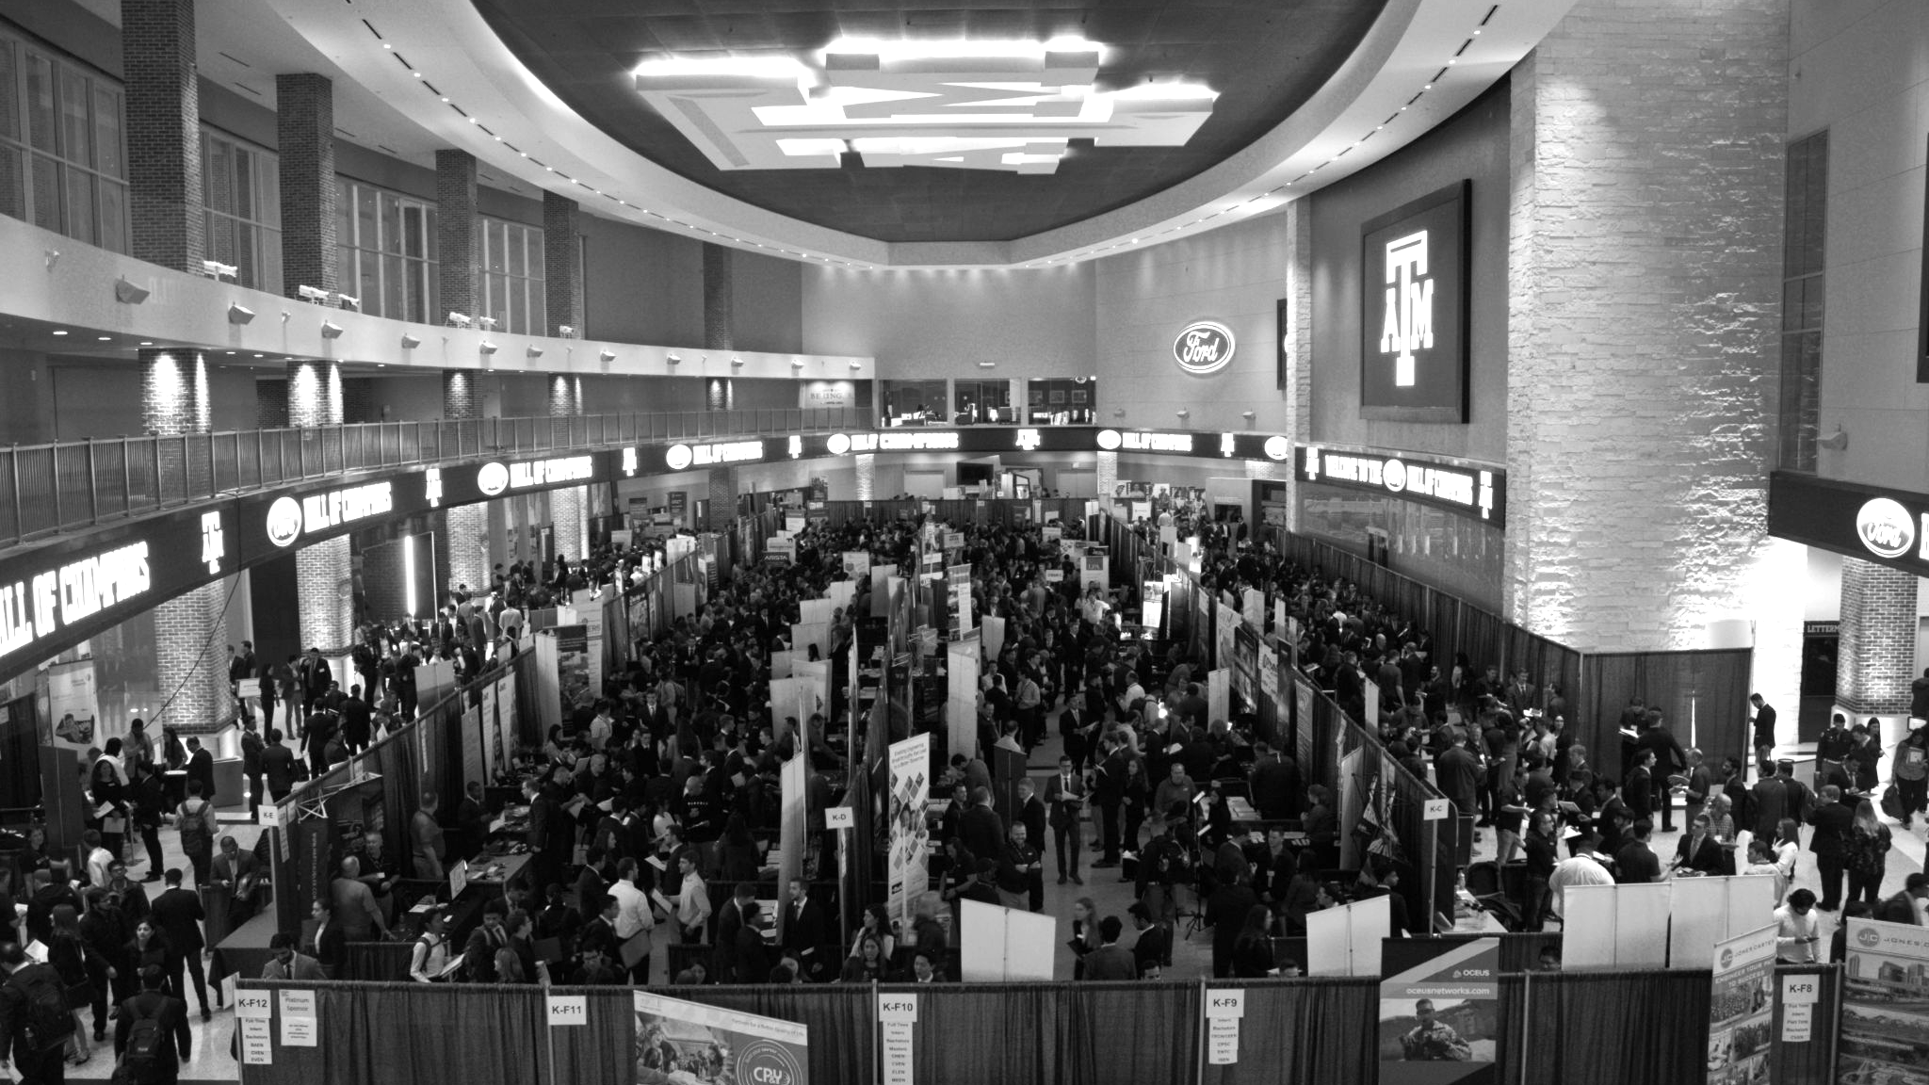

LANL Team Update
10/16/2024
Izzy Baumler, Dalton Boeckmann, Morgan Gullo, Jade Waldron

Slide 2
Mission Statement
There should be such a technology that has 6 DOF and can move through its full range of motion in each degree of freedom at 1 Hz.
Constraints:
Degrees of freedom
Workspace
Weight
Strength
Speed of movement

Slide 3
Weekly Updates
Met with sponsor to establish constraints for project
Sent out customer needs survey
Finalized functional model
Completed idea generation concepts

Slide 4
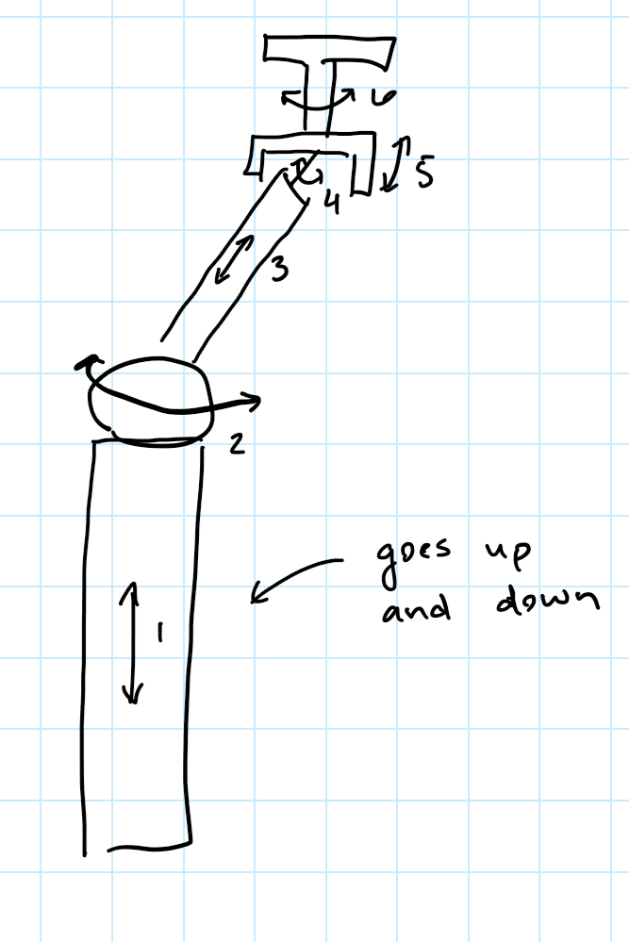
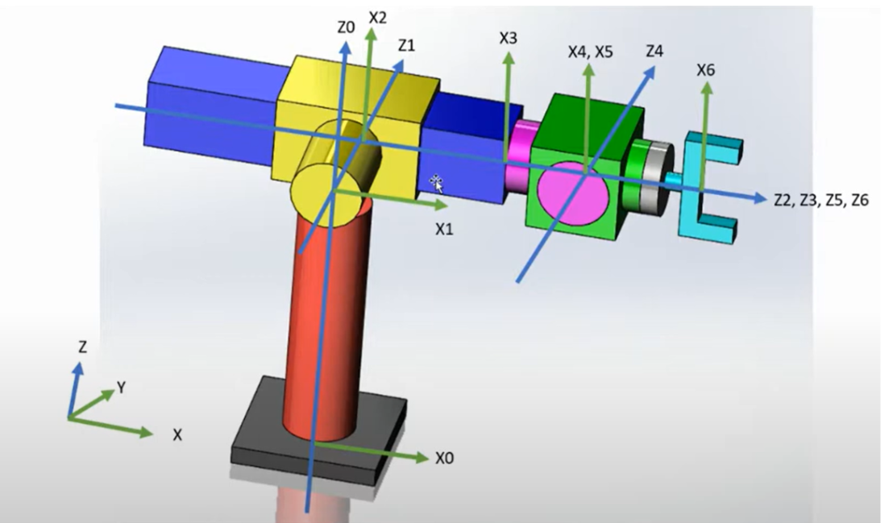
Idea 1: Telescopic Arm
Inspired by Stanford Manipulator
Bottom joint would move up to increase workspace
Most of maneuverability is at wrist

Slide 5
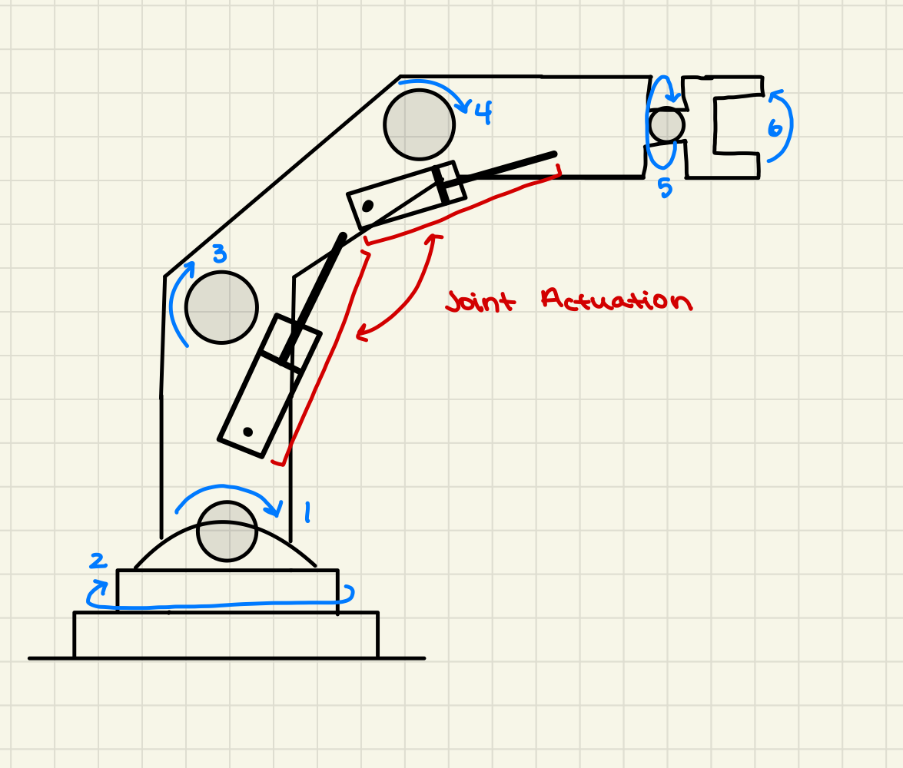
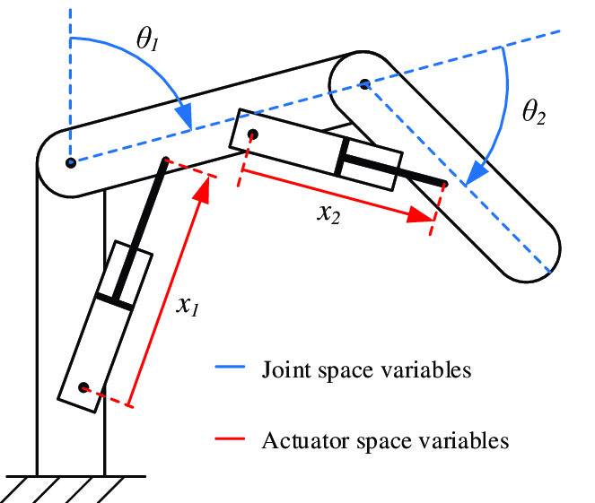
Idea 2: Joint Actuation

Slide 6
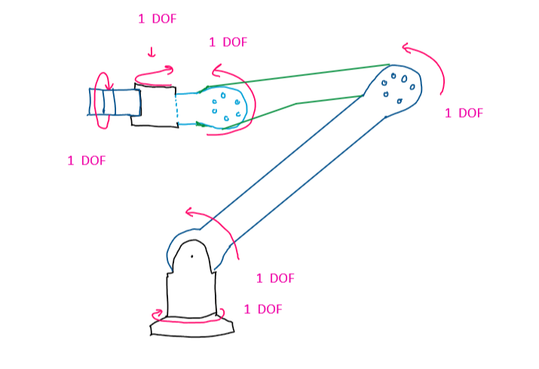
Idea 3: Motors
Housing: 3D Printing or machining
Actuation/Motors:
Brushless DC motors, good for high torque
Servomotor

Slide 7
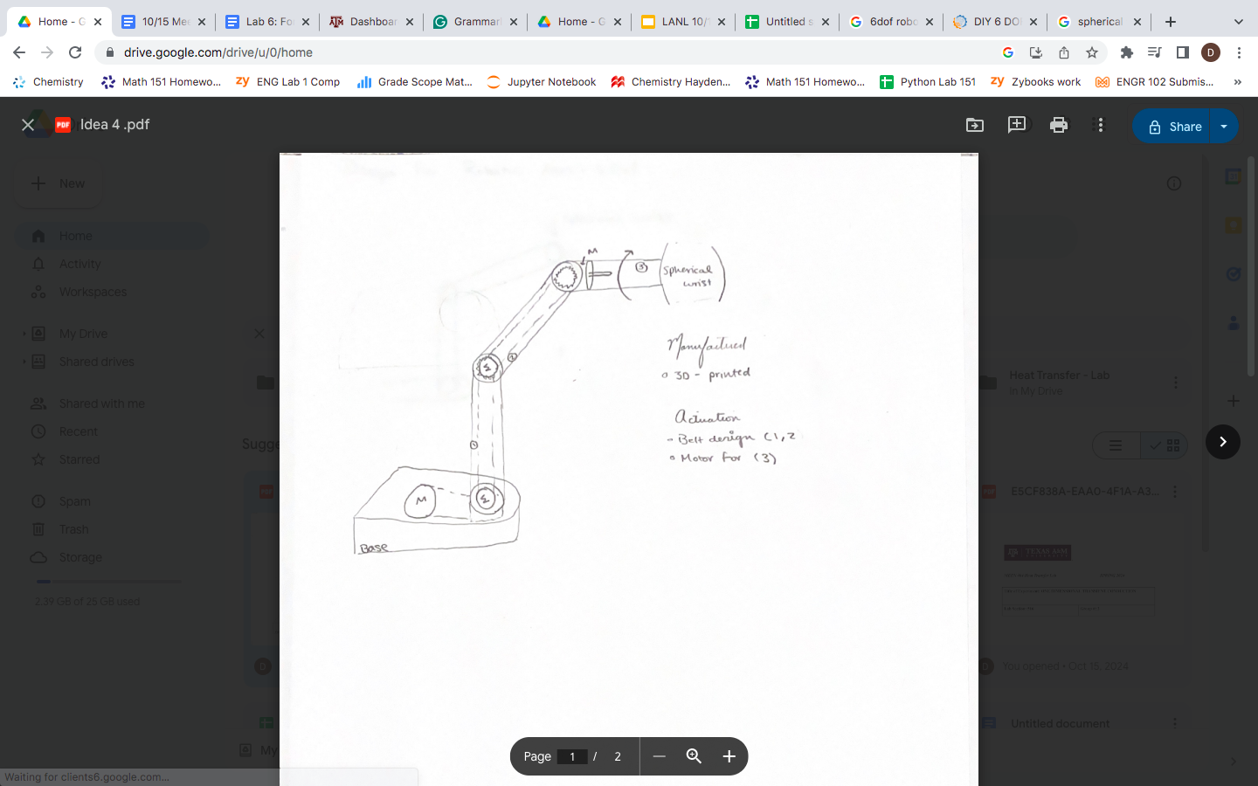
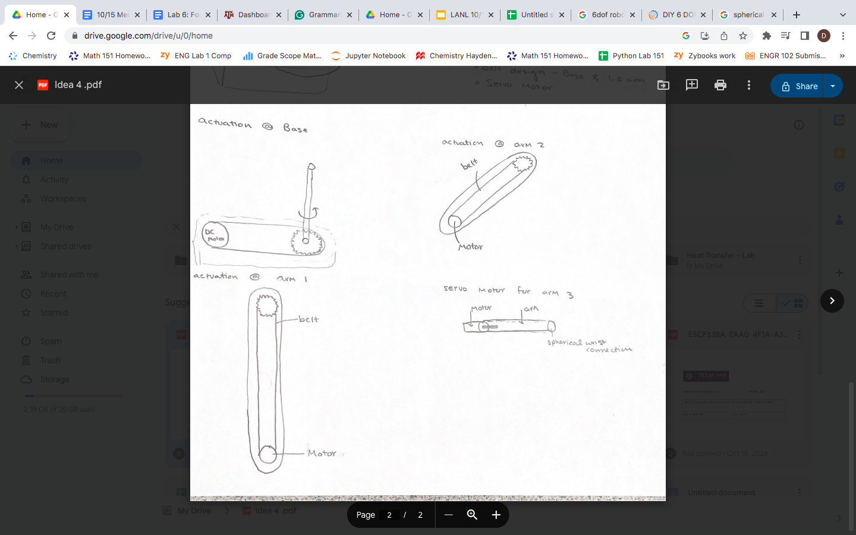
Idea 4: Belt and Motor Actuation

Slide 8
Customer Data - Supplemental Survey
# | Designated Need | Importance Score (1 to 5, 5 = most important)
1 | Highly Maneuverable/Fast | 5
2 | Precise/Accurate Control | 4
3 | Versatile | 4
4 | Durable under harsh conditions | 4
5 | Stable | 4
6 | Operates for Long Durations | 3
7 | Lightweight | 3
8 | Semi-Autonomous | 2

Slide 9
Customer Data - Interviews
Question | Customer Statement (Rodrigo Ramon) | Customer Statement (Michael Tomlin) | Interpreted Need | Weight | Activity
What specific motions would you expect the robot /robotic arm to handle on a regular basis? (Movement, force) | The robot should be capable of moving back and forth over a specific area during cleaning operations. | The robot needs to perform sweeping motions and accurately identify the edges of curved surfaces on the wall, requiring mathematical precision to navigate these arcs effectively. | The robotic arm must be able to perform repetitive back-and-forth movements over designated areas while also executing sweeping motions to ensure thorough cleaning. | 3 | Executing precise movement patterns to clean specified areas and navigate curved wall surfaces effectively.

Slide 10
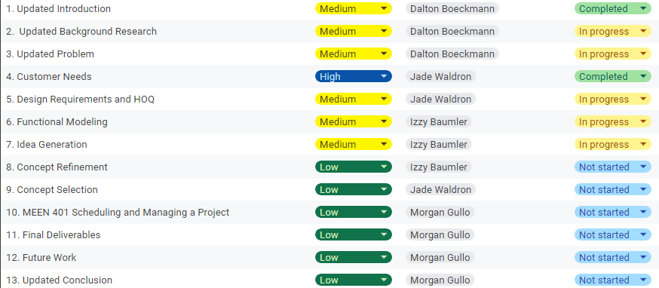
Schedule

Slide 11
Upcoming Week
Perform concept refinement to determine specifications for final design
Continue working on DR2 report and presentation
Follow up with Dr. Pagilla to see his lab and ask questions

